Slide 1
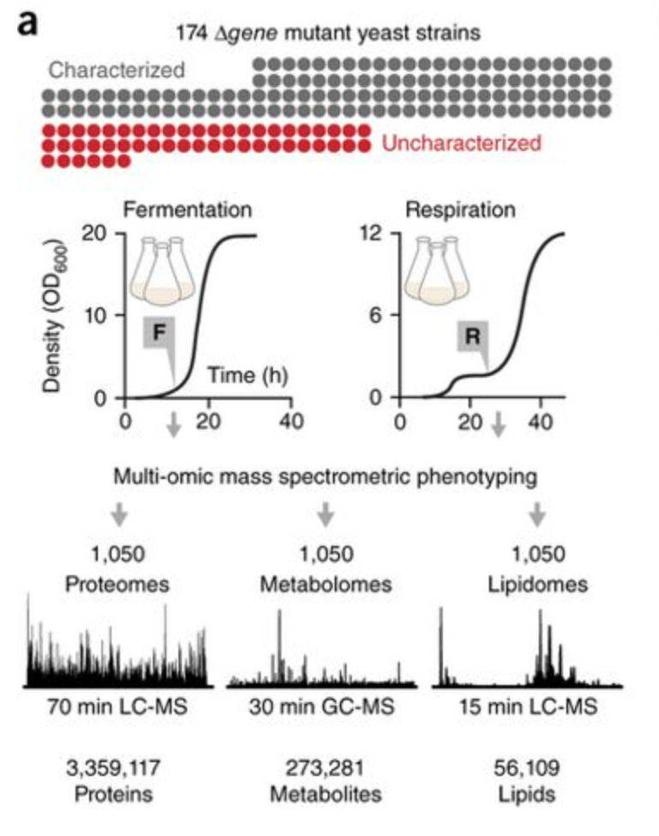
The Yeast 3 Thousand (Y3K) Dataset
1000 proteomes, 1000 lipidomes, and 1000 metabolomes
Profiled with an aim of better understanding mitochondrial biology
174 yeast strains, “each lacking a single gene related to mitochondrial biology”
Two distinct metabolic conditions
In biological triplicates
(174 deletion strains+1 wt)*2 conditions*3 biological replicates=1050 samples
Respiration: a special growth condition optimized to be highly reproducible and to activate mitochondrial respiration.
Fermentation: a standard early log phase high-glucose growth condition that activates glycolysis and fermentation and represses mitochondrial respiration.

Slide 2
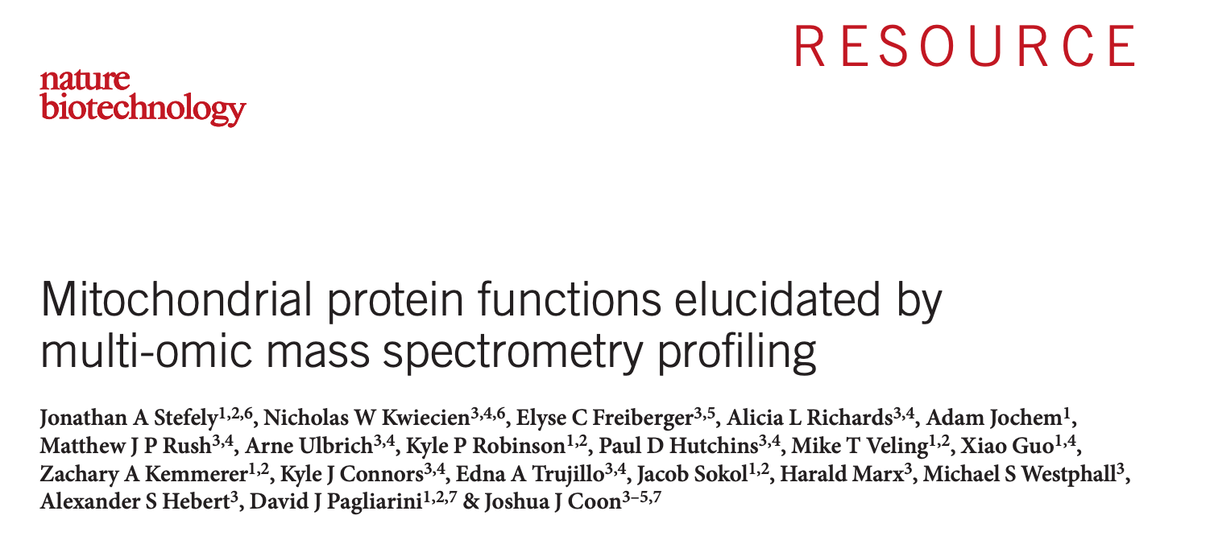
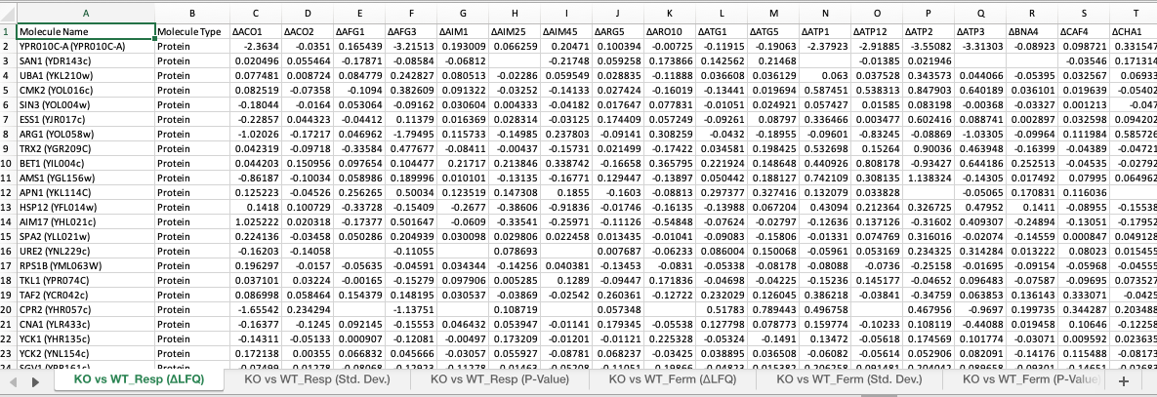

Slide 3
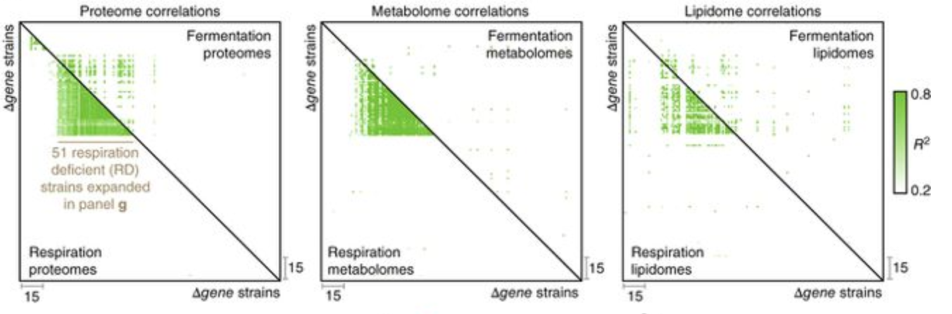
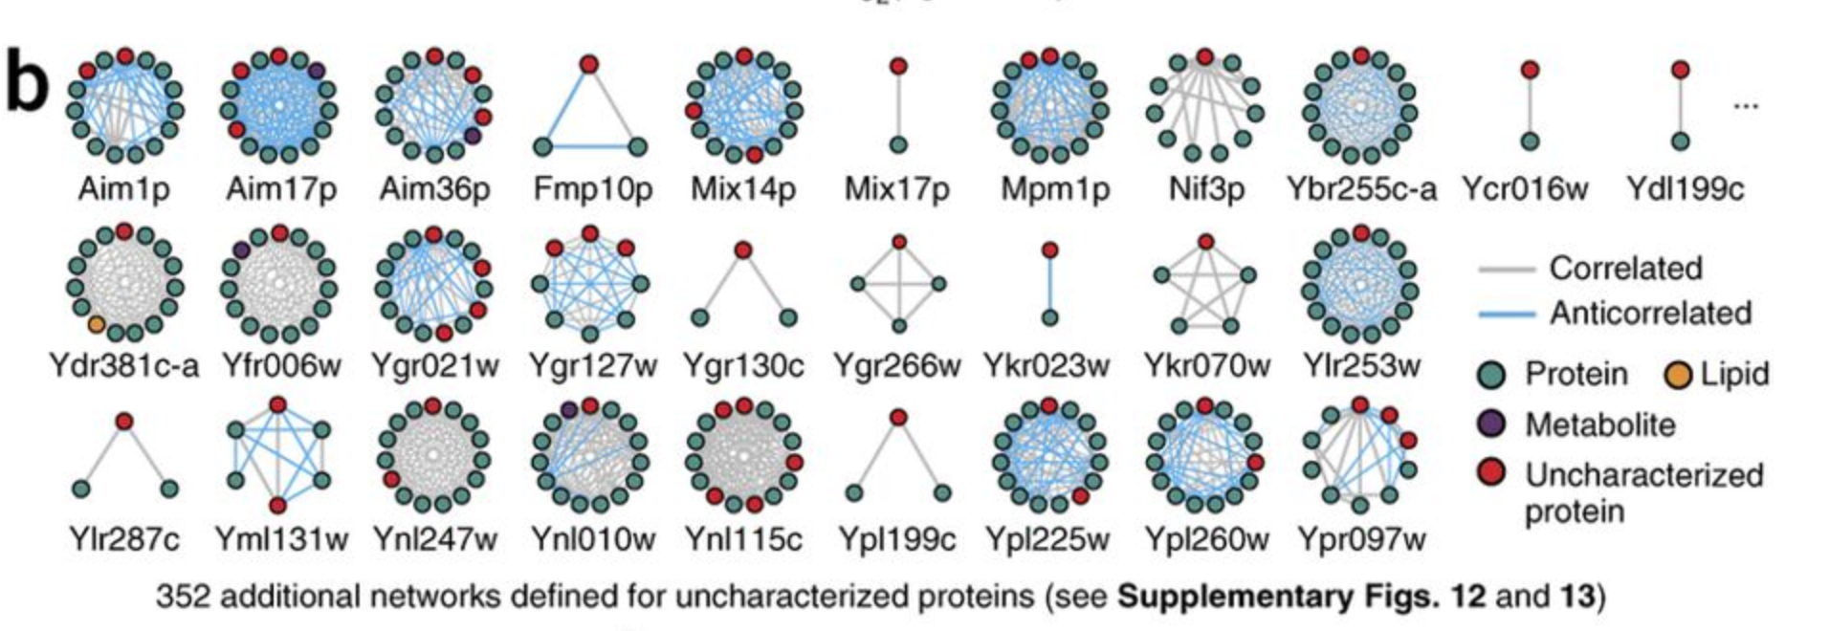
System biology the authors have done
Regression analysis of global perturbation profiles
𝝙gene-𝝙gene correlation across all strains inducated numerous functional relationships, with stronger correlations observed in respiration.
Molecular covariance network analysis
Pairwise covariance between proteins, metabolites, and lipids.
Similar to mRNA coexpression profiling.
Can be used to predict gene function.

Slide 4
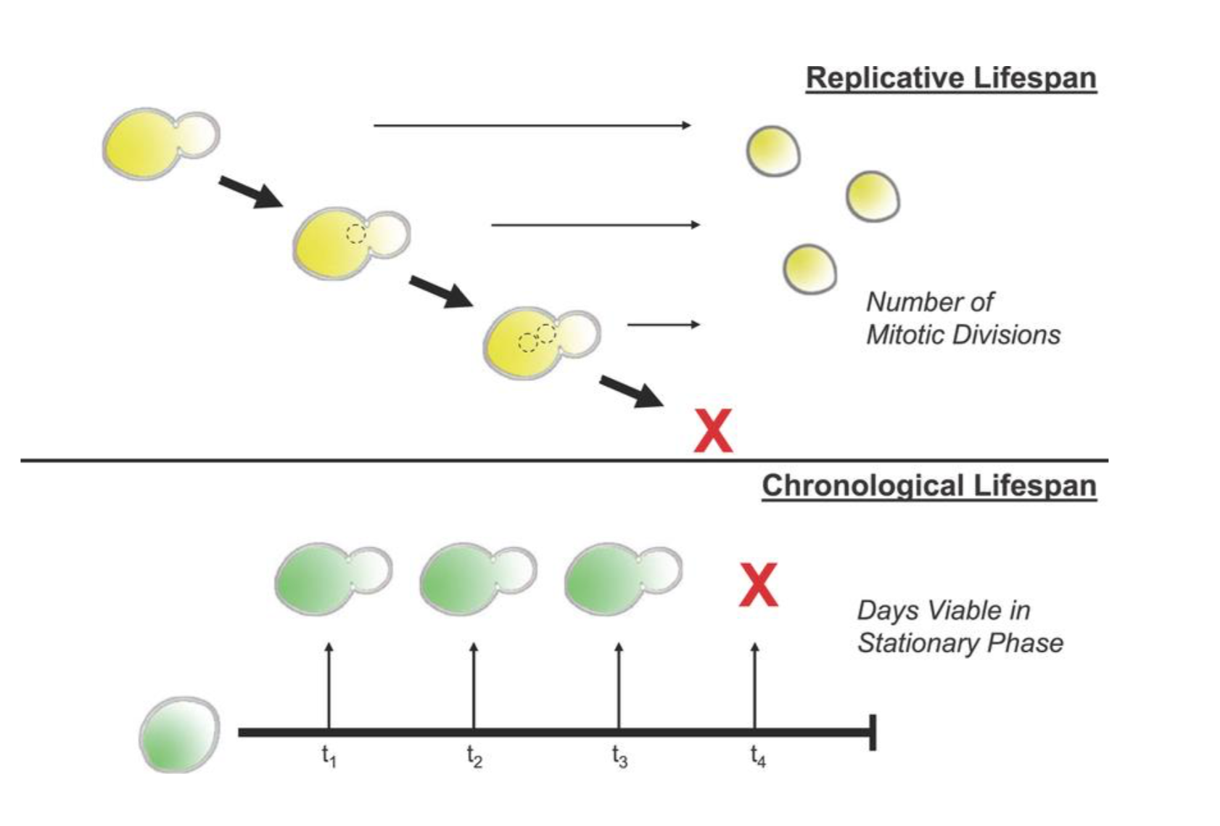
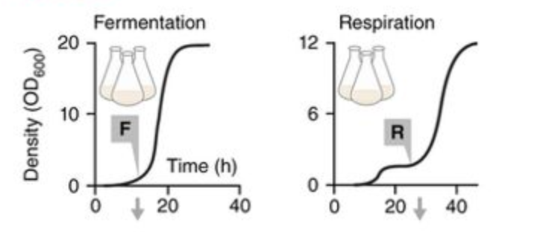
Alaattin Kaya’s addition to Y3K
Organismal phenotypes:
Chronological lifespan
Mean and maximal replicative lifespan
Respiration density
Fermentation density

Slide 5
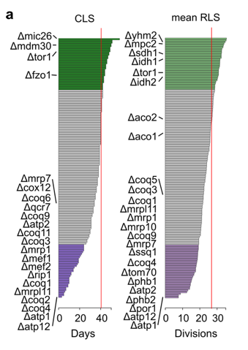
Short chronological lifespan:
Deletions in mitochondrial ATP synthase
Deletion affecting mitochondrial electron transport chain complexes or their aseembly
Defective in biosynthesis of ubiquinone
Long chronological lifespan:
Deletion in mitochondrial ribosomes
Deletion of a subunit of TOR
Disruption of mitofusin and its associated proteins

Slide 6
Additional questions we can ask with the phenotypic data?
CLS ~ Respiration omics
RLS ~ Fermentation omics

